Slide 1
TOPIC:AUTOMATED SORTING SYSTEM
USING ULTRASONIC, RTC AND MICRO CONTROLLER
MODULE CODE AND TITLE: ITLES801 – EMBEDDED SYSTEM DEVELOPMENT
PROGRAM: INFORMATION TECHNOLOGY
Names :NIYIGABA Claude 24rp14647 SIMBI Nicole 24rp15326 IRADUKUNDA Mugisha enock 24rp15801

Slide 2
INTRODUCTION
The Automated Sorting System is designed to enhance efficiency in industrial and recycling environments by sorting objects based on criteria like size or material. Using an Ultrasonic Sensor, the system measures the size of objects passing through on a conveyor belt. The data from the sensor is then processed by a Microcontroller, which controls a Servo Motor to divert the objects into designated bins according to their size. To ensure the system operates at the right times, a Real-Time Clock (RTC) is used to schedule sorting during specific hours, such as production shifts. For advanced sorting capabilities, the system can incorporate optional features such as weight sensors for precise categorization. This modular design ensures scalability and flexibility, making the system adaptable to various industrial requirements. By enhancing precision and efficiency, the system reduces manual effort and boosts overall productivity

Slide 3
PROBLEM STATEMENT
Manual system can prone to error
Reduce productivity due to sorting delay
Time and energy efficient problem
Mixed sorting challenge
Object tracking and sorting
High cost of advanced sorting system
Lack of scheduler automation

Slide 4
General objective
To design and develop an automated object-sorting system using embedded systems that efficiently sorts objects on a conveyor belt based on their size, material, to improving productivity and reducing human intervention.

Slide 5
Specific objective
Develop object detection system
Design sorting mechanism
Program a microcontroller to control servo motors or actuators to divert objects into designated bins based on size or material.
Develop a Real-Time Sorting System
Ensure continuous operation
Improve sorting accuracy with advanced component
Optimize energy usage

Slide 6
Component used
Ultrasonic sensor:a device that uses sound waves to measure distance or detect objects.
Micro controller: a small computer on a single integrated circuit (IC) that contains a processor, memory (RAM and ROM), and input/output (I/O) peripherals.
Real-time clock(RTC):a specialized electronic circuit that keeps track of the current time and date, even when the main system (like a computer or microcontroller) is powered off.
Lcd Display:is to display visual information in a clear and energy-efficient manner
Servo motor:is a specialized type of motor that is used for precise control of angular position, speed, and acceleration

Slide 7
Scope of Automated object sorting system
This Automated Object Sorting System is designed to operate continuously in industrial or recycling environments, sorting objects based on their size (and optionally by material or weight). The system will feature components that ensure seamless, efficient operation throughout all hours of the day, optimizing workflow and maintaining productivity without interruptions

Slide 8
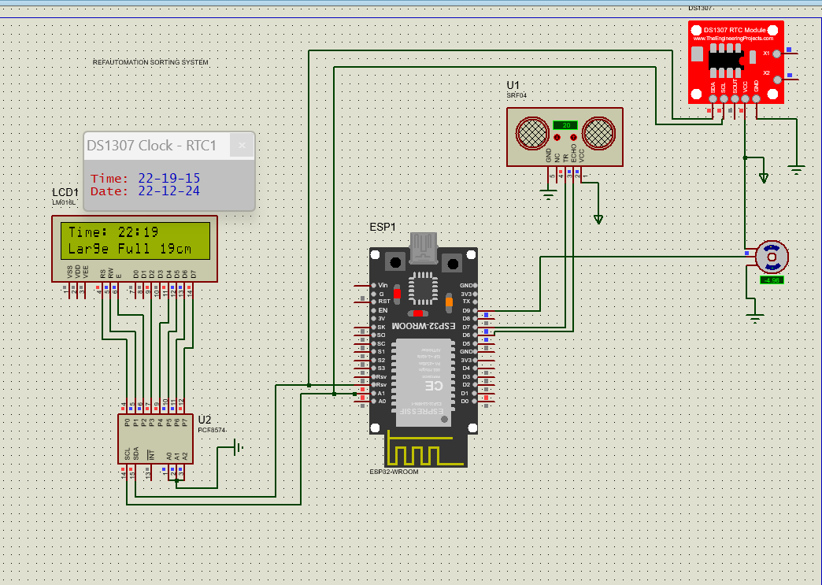
DIAGRAM

Slide 9
Thank you!!!!

